Slide 1
Public Consultation – Multiuse trail

Slide 2
Background
Resident committee
Need for Multiuse Trail network
Discussion with The Town

Slide 3
Background
Discussion with Government of NL
Environmental Assessment
Permitting

Slide 4
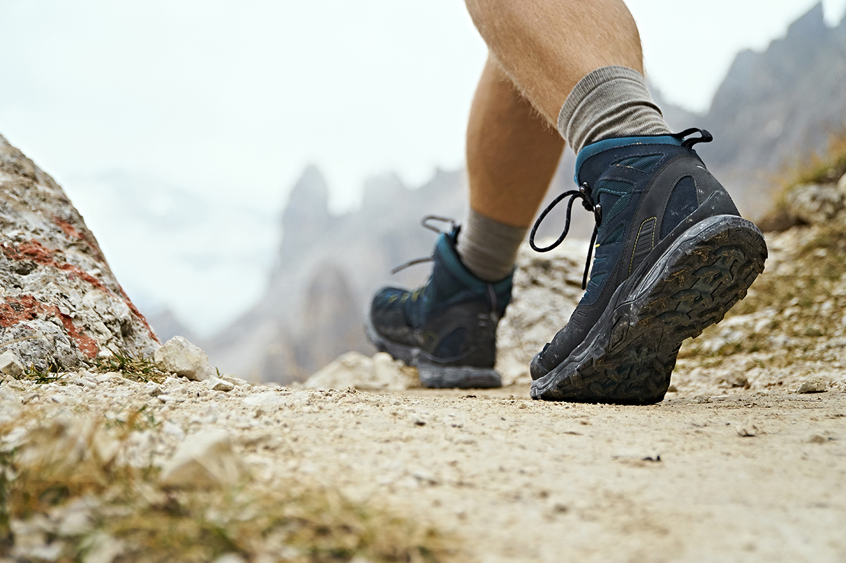
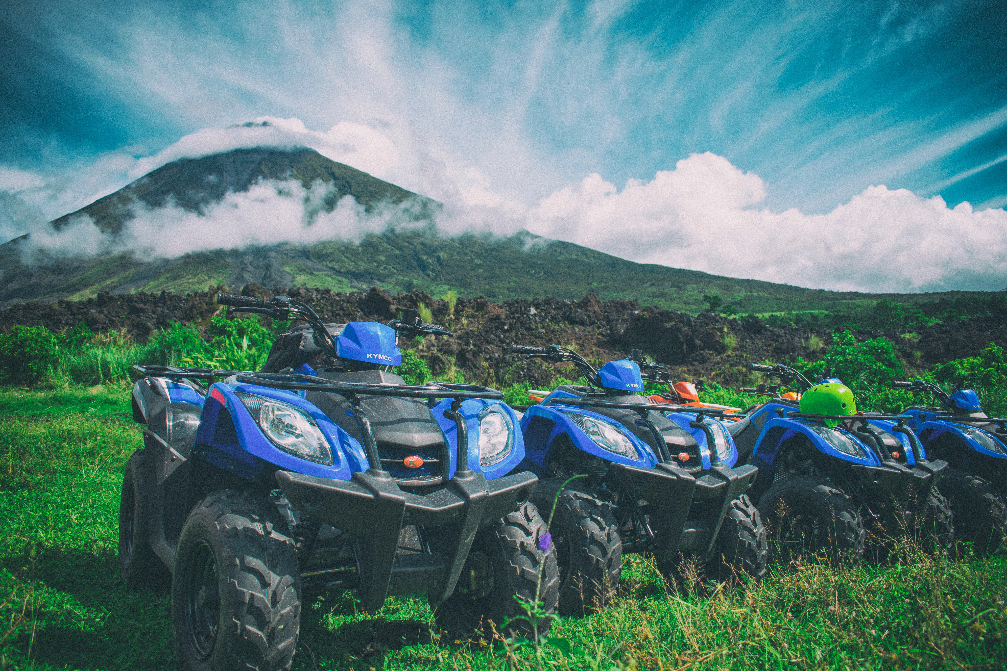
Benefits of multiuse trail
Connectivity of community
Recreation Opportunities
Economic Development Impact
Decrease road use of ATVS

Slide 5
Crown Land Permit

Slide 6
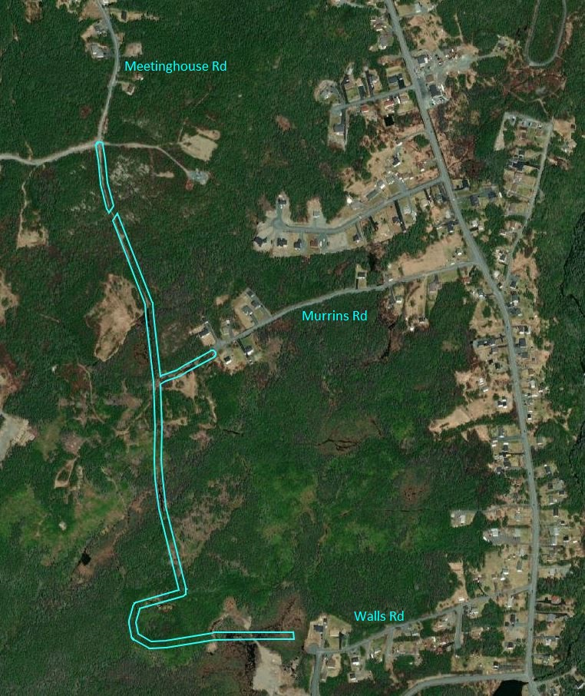
Current area for trail development

Slide 7
Today
Resident Feedback
Thank you

